Slide 1
Digital storytelling
Human narratives in a digital age
By Utitofon Inyang,
Department of Comparative Literature, ucr.

Slide 2
Digital humanities: towards definitions
The term can mean anything from media studies to electronic art, from data mining to edutech, from scholarly editing to anarchic blogging, while inviting code junkies, digital artists, standards wonks, transhumanists, game theorists, free culture advocates, archivists, librarians, and edupunks under its capacious canvas.
Stephen Ramsay, “Who’s In and Who’s Out” Defining Digital Humanities. 2013,P. 239
The proper object of Digital Humanities is what one might call “media consciousness” in a digital age, a particular kind of critical attitude analogous to, and indeed continuous with, a more general media consciousness as applied to cultural production in any nation or period.
Wendell Piez, “Something Called Digital Humanities”, Defining Digital Humanities. 2013, P.191

Slide 3
Central Concerns of Dh
Not only do we study digital media and the cultures and cultural impacts of digital media; also we are concerned with designing and making them.
an intimacy and connection …founded in the individual scholar’s role as a creator and producer of media, not just a consumer.
Wendell Piez, “Something Called Digital Humanities”, Defining Digital Humanities. 2013, P.191

Slide 4
Focus of the Workshop
Explore content, style, and writing strategies for successful Digital Storytelling projects with a focus on the format, approaches and media of digital storytelling in the humanities.
Explore different ways of pairing the storytelling techne and technology
Learn how to incorporate of narrative techniques and a blend of video, audio, images, and text into research presentations
Learn simple DS platforms. features, affordances that can be used to create amazing projects with a greater range of creativity

Slide 5
Digital Storytelling: origins
The practice of digital storytelling, under the leadership of Lambert, Atchley, and Mullen, began with creating videos 2–3 min in length often augmented with voice narration, images, text, and perhaps music. Today, given the multitude of digital media available, approaches to digital storytelling can take many forms, from artist books to “zines” (Lambert, 2002).
Digital storytelling is a dynamic site of interaction for interdisciplinary scholarship, teaching, and creative practices. The convergence of digital tools and social collaboration opportunities will enhance scholars and learners ability to create and communicate interactive narratives. It can make practice and training for all scholars students more diverse, personalised, compelling and realistic and engaging.

Slide 6
DIGITAL STORYTELING: telling STORIES WITH DATA
Digital storytelling - digital content/media + the art of storytelling. Formats: documentaries, essays, historical/eye witness accounts, memoirs, narratives, research findings/presentations, and more.
Digital storytellers: anyone with a desire to document life experience, ideas, or feelings through the use of story and digital media.
Research question "How might digital scholarship facilitate the collection, organization, and presentation of information and narrative structures?"
John F. Barber, http://www.nouspace.net/john/resources/resources-storytelling.html

Slide 7
DS AND MY PROJECT
How does AF fit together with Digital Humanities?
My research in Comparative Literature engages African literature and culture in the contexts of history, memory, critical theory and pedagogy. Within African literature, the storyteller is the holder of legend and history. The African oral tradition is considered the bedrock of contemporary written African literature. While Literary research intrinsically depends on narrative interpretation, the tools and technologies available for exploring narratives has changed in today’s digital age. Long after people forget facts and figures, we remember stories. Digital stories are vehicles of self-expression that promote communication, stimulate critical thinking and enable independent learning.

Slide 8
Digital Storytelling:
What Story do you want to tell? – Idea/Techne
What Medium/ Media will help your story? – Digital Tools

Slide 9
Digital storytelling: Skills
Reflection on experience
Shared language for critical analysis of texts
Practice process-oriented writing
Understanding of sequence and logical flow
Generation of discussion around the ideas, beliefs, and feelings regarding the resolution

Slide 10
DIGITAL STORYTELLING PROCESS
Step 1: Identify/
Articulate an Idea
Step 6:
Combine to Create your Story
Step 7:
Share
Step 8: Feedback
Step 2: Research/ Explore
Step 3: Write
Step 4: Storyboard
Step 5: Gather/Create Images, Audio, Video

Slide 11
critical thinking, communication, digital literacy, and civic engagement.
Techne + Tool What do you need
Teach an Academic Concept
Teach a Specific Skill
Narrating an Experience
Create Impact
Your data – essay, history, article, idea
Your narrative template
Your Digital Tools

Slide 12
Sample DH PROJECTS
https://dtc-wsuv.org/remembering-the-dead/
http://revolt.axismaps.com/project.html
https://imaginerio.org/#en
https://artsandculture.google.com/project/heritage-on-the-edge
https://storymap.knightlab.com/examples/bosch-garden/
https://storymap.knightlab.com/examples/aryas-journey/

Slide 13
Digital storytelling resources
Unsplash.com: https://unsplash.com/
Images from Creative Commons: https://search.creativecommons.org/
Flickr.com: https://www.flickr.com/
Images.google.com
Use Canva.com to create and customize images

Slide 14
Digital storytelling TOOLS
Twine - https://twinery.org
Soundcite - https://soundcite.knightlab.com
Scene - https://scene.knightlab.com
Juxtapose - https://juxtapose.knightlab.com
ArcGIS Pro by Esri - https://www.esri.com/en-us/arcgis/products/arcgis-pro/overview

Slide 15
practice session
STORYMAPSJS BY KNIGHTLAB- Northwestern University
https://docs.google.com/document/d/1dijOSUwJJoMzpxGkU6uNCD0R6cNjV7GCLzW5YMI8qTw/edit?usp=sharing
TIMELINE by Knightlab
https://docs.google.com/spreadsheets/d/1cTI_n8Rj10_1npvjzlr7kWxprXuRnkkWGOuGyBEYQtc/edit#gid=0
https://cdn.knightlab.com/libs/timeline3/latest/embed/index.html?source=1cTI_n8Rj10_1npvjzlr7kWxprXuRnkkWGOuGyBEYQtc&font=Default&lang=en&initial_zoom=2&height=650
https://storymap.knightlab.com/edit/?id=practice
https://uploads.knightlab.com/storymapjs/a6f509bd911a5067e63b0faf280d8020/practice/index.html

Slide 16
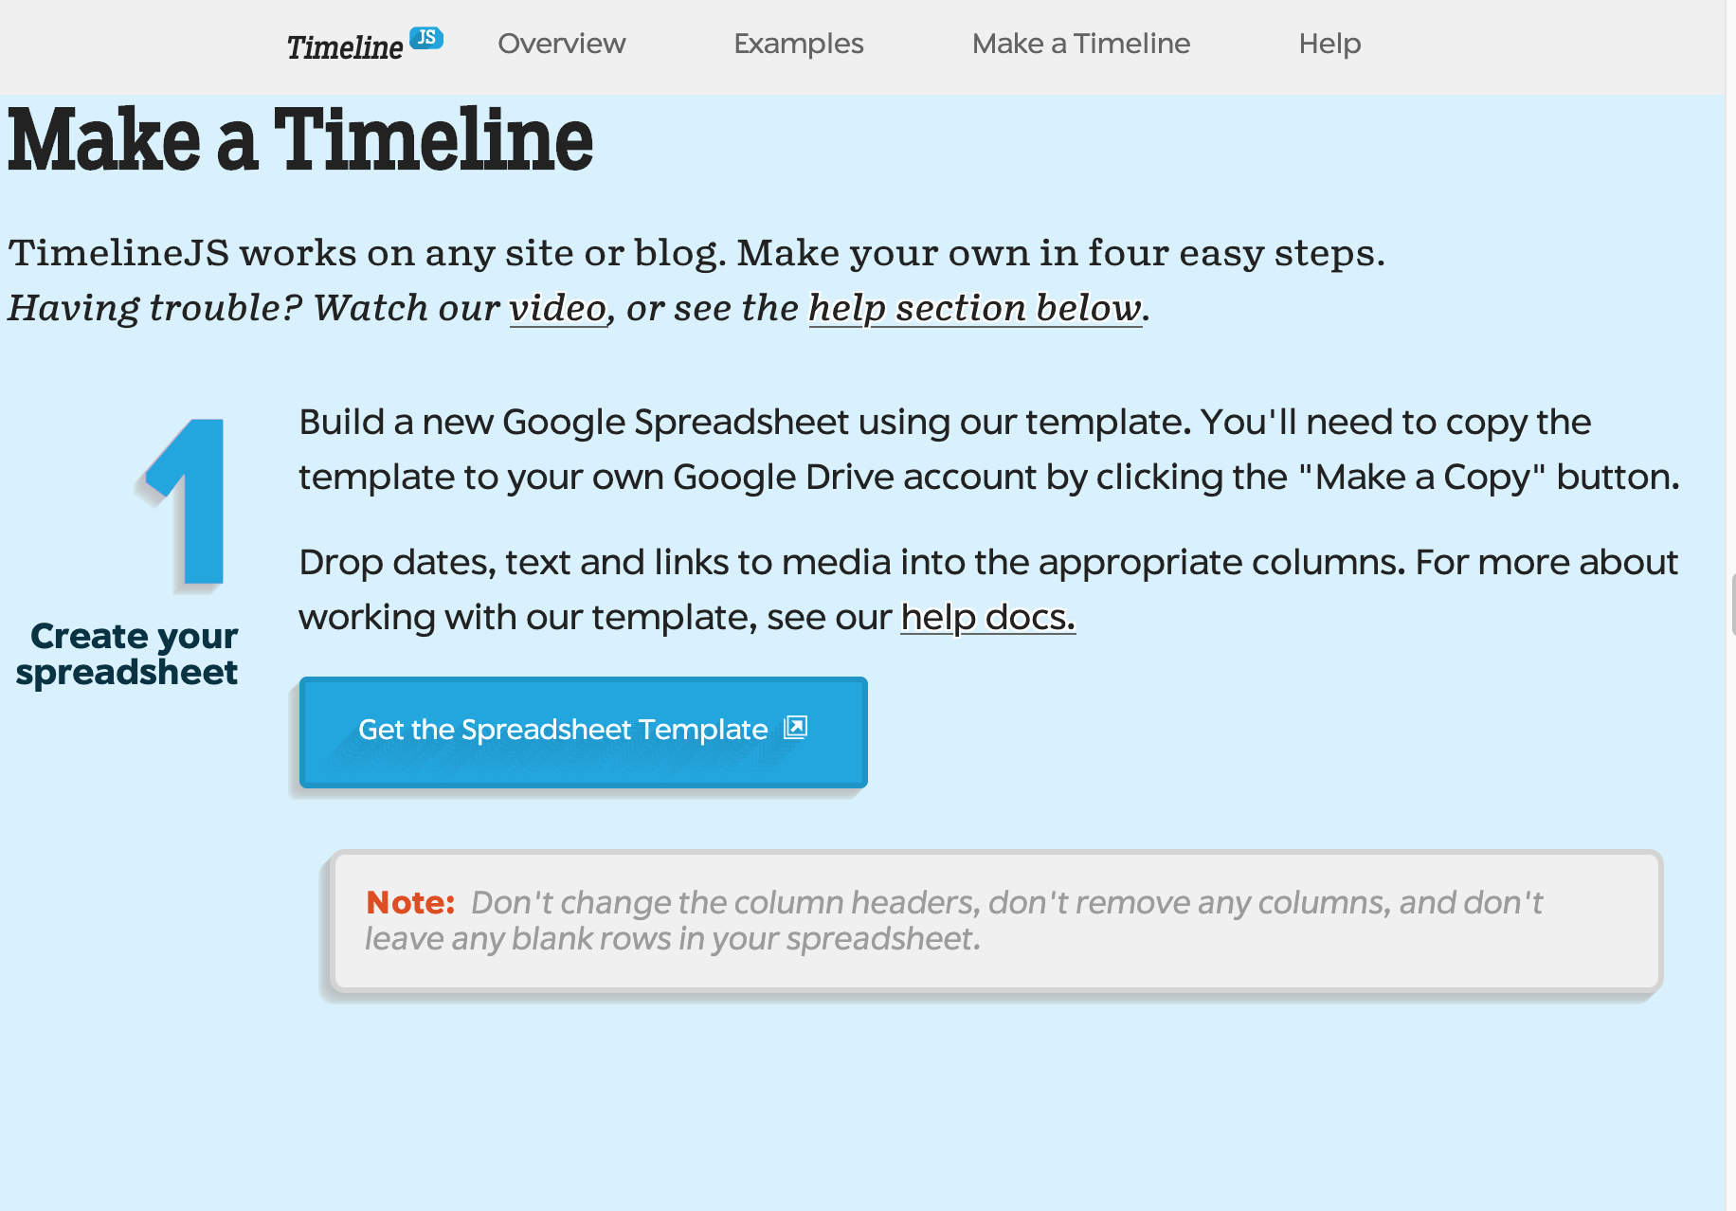
Practice: 1

Slide 17
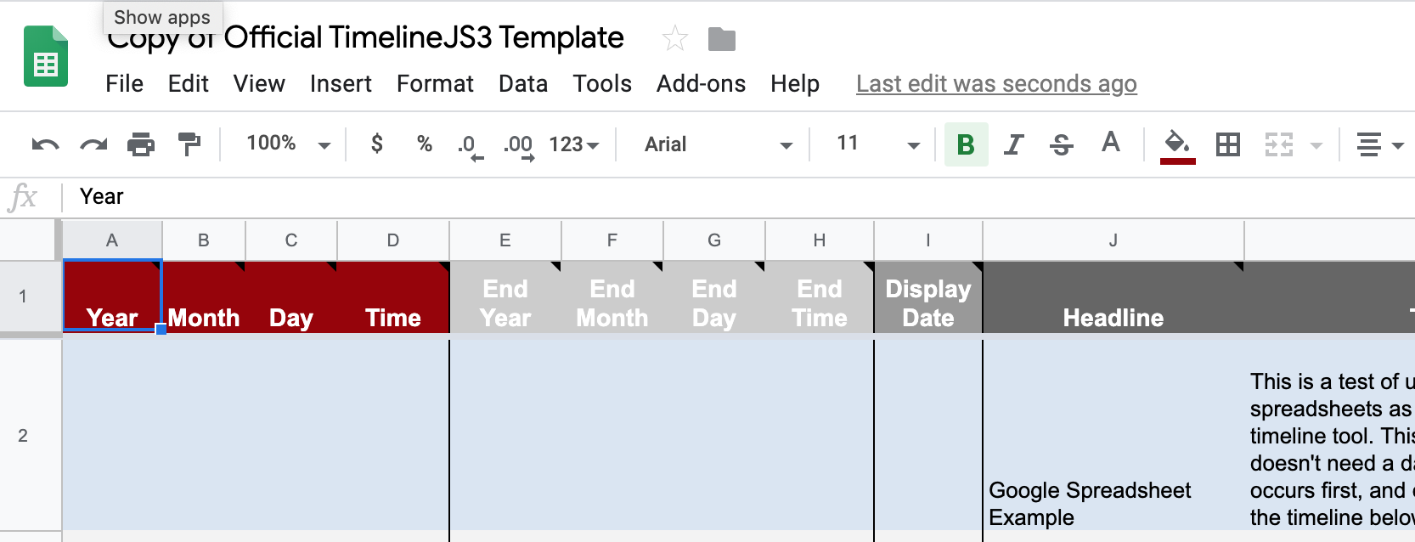
PRACTICE: 2

Slide 18
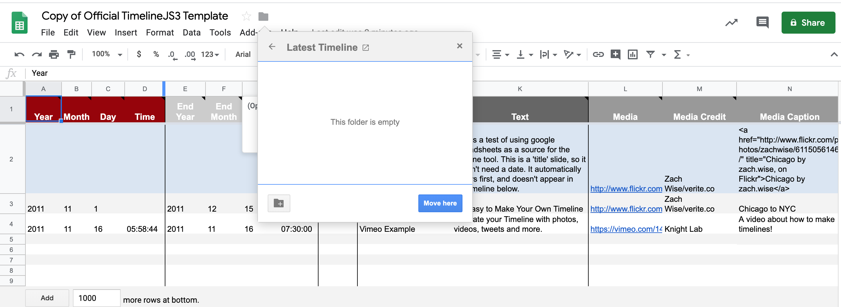
PRACTICE: 3

Slide 19
essentials FOR success
1. Choose and articulate your idea
2. Choose the right media tools
3. Critical decisions about the structures of the story and how they might connect, through different digital media forms, with an intended audience.
4. Project planning and content production -The importance of drafting, revising and editing in writing, for both.
5. Assessment and selection of appropriate digital media to achieve specific narrative goals and objectives.
6. How research and scholarship evolves recursively from idea to final artifact.

